Slide 1
Faculty/Staff Meeting
Friday, September 10, 2021
Notes:
The Powerpoint backgrounds are locked. You are able to still adjust the text boxes. You can edit the boxes size, location, font color, font size, etc.
If you have a change request, please send a request to the Marketing and Communications request portal.
https://resources.uta.edu/business/marketing-and-communications.php

Slide 2
Agenda
New colleagues
Spring teaching awards
Congratulations
Updates
Diversity initiatives
Research news
Teaching issues
Dean’s Comments

Slide 3
Housekeeping Items
Session is hybrid—in classroom and virtual
If virtual, mute unless speaking
If virtual, feel free to use the ‘raise hand’ and ‘chat’ functions – we will monitor those
Session is being recorded and transcribed
Meeting minutes and ppt slides will be posted on the faculty/staff pages of the COB website
Recording will be available on the meeting chat channel

Slide 4
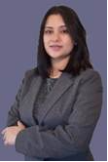
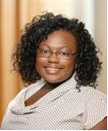
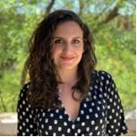
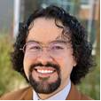
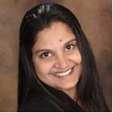

Welcome!
Welcome New Faculty!
Dr. Chandrani Chatterjee, ACCT Dr. Courtney Hart, MANA
Dr. Antonia Gkergki, ECON Dr. J. Daniel Martinez Garcia, MARK
Dr. Ramya Aroul, FINA Dr. Xianghua (Jason) Wu, ISOM

Slide 5
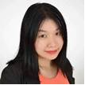
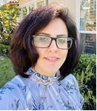
Welcome!
Welcome New Faculty!
Dr. Qiang Ruan, ISOM
Dr. Neshat Beheshti, ISOM

Slide 6
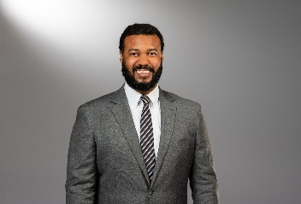
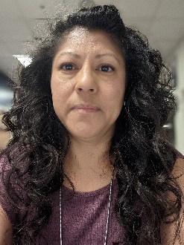
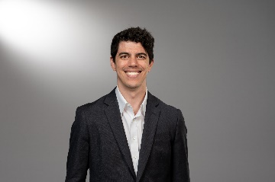
Welcome!
Welcome New Staff!
Jason Pooler, Academic Advisor II, UG Kathy Mendez, Support Specialist II, ECON
Adam Majors, Graduate Recruiter – FTW Campus
Adrienne King, Advisor I, UG

Slide 7

Teaching Awards
(from Spring)
Teaching Awards Committee:
Drs. Crowder, Freling, Tom Hall, Lavelle, Nerur, Sarkar
Outstanding Graduate Teaching Associate: Anh Tuan Nguyen (FINA)
Outstanding Adjunct Instructor: Matthew Hirst (MANA)
Outstanding Non-Tenure-Track Faculty: Stan Seat (ACCT)
Outstanding Undergraduate Teaching: David Rakowski (FINA)
Outstanding Graduate Teaching: Sriram Villupuram (FINA)

Slide 8
Congratulations!
Faculty Promotions
Christy Spivey, ECON
- Promoted from Clinical Associate Professor to Clinical Professor

Slide 9
Congratulations!
Staff Promotions
Ellen Long, UG Adv
- Academic Advisor II

Slide 10
Congratulations!
Aaron Smallwood
Faculty Development Leave

Slide 11
Congratulations!
Sanjiv Sabherwal
Eunice and James L. West Chair of Private Enterprise and Entrepreneurship
Jennifer Zhang
Daniel Himarios Endowed Chair

Slide 12
Congratulations!
Mahmut Yasar
Goolsby-Jacqualyn A. Fouse Endowed Chair
Jingguo Wang
Eunice and James L. West Distinguished Professorship (A)
Fred Miao
John Merrill Endowed Professorship in Consultative Sales

Slide 13
Congratulations!
Elite journal acceptances last year:
ACCT-Yuan Ji—The Accounting Review
FINA-Sanjiv Sabherwal—MIS Quarterly
ISOM-Zhuojun Gu—Management Science
ISOM-Chai Sambhara—Information Systems Research
ISOM-Mahyar Vaghefi—Jrnl. of Assoc. for Info. Sys.
ISOM-Kay-Yut Chen & Jingguo Wang—Mgmt. Science
ISOM-Jennifer Zhang—Jrnl. of Mgmt. Info. Systems
MARK-Fred Miao—Journal of Marketing

Slide 14
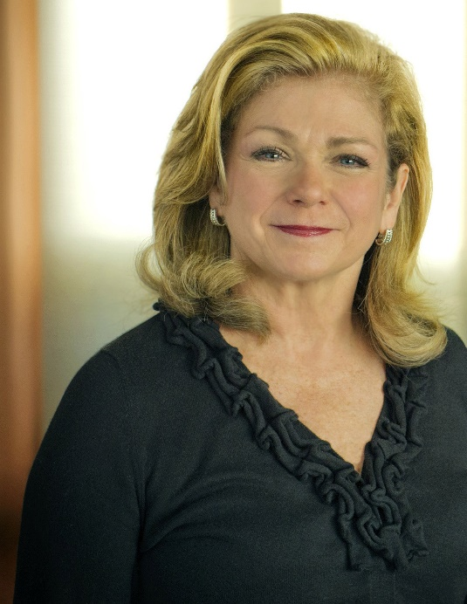
Ann
McFadyen
Millican
1958-2021
We are sad to announce the passing of Dr. Ann McFadyen Millican on August 14, 2021. Her love, laughter, and generosity with students, colleagues, staff, friends and family will be dearly missed by all.

Slide 15
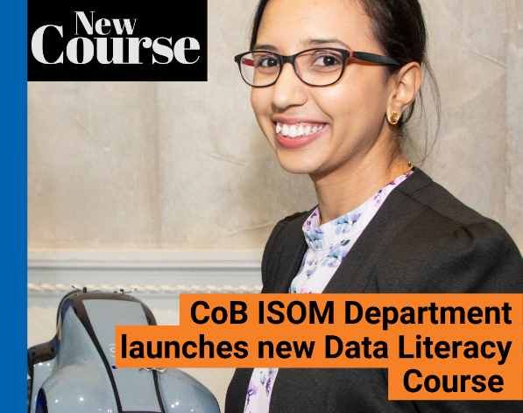
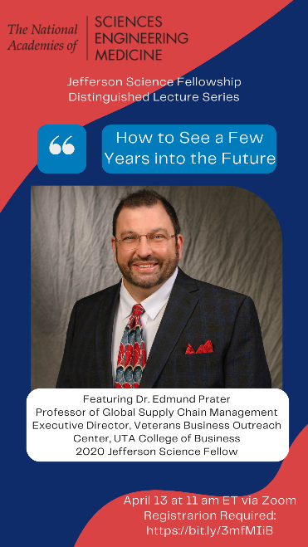
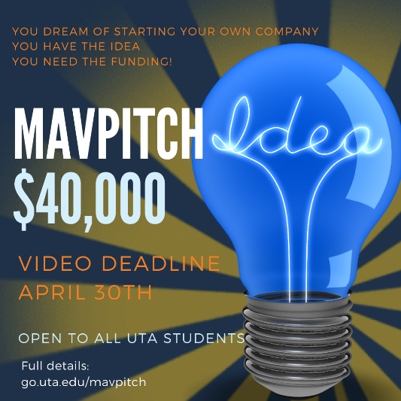
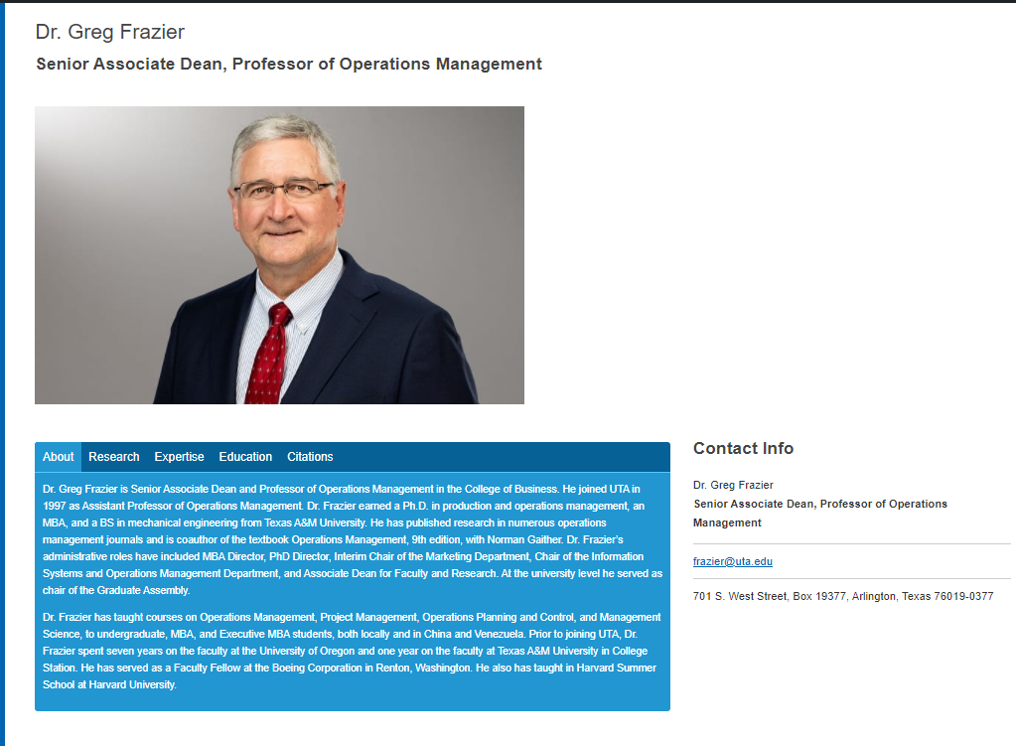
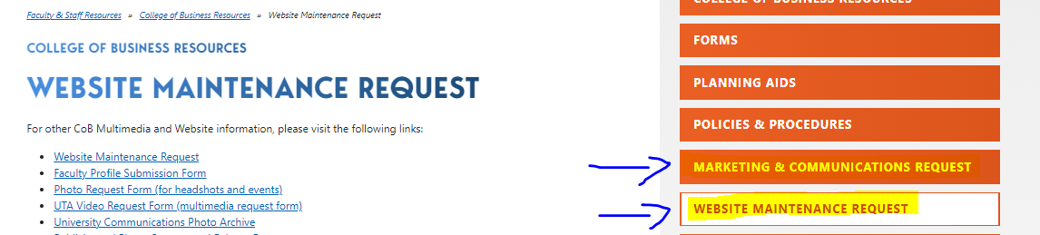
Marketing Team Reminders
Marketing
Social Media
Accomplishments, Events, programs, etc.
Request form
Posting in Building
Website
Checking and verifying faculty page and sending updates/corrections
The forms for updating and adding profiles are linked in the nav bar of the blog website https://blog.uta.edu/cob/
Check departments pages and submit any changes needed to normal web request form https://resources.uta.edu/business/website-maintenance-request.php.

Slide 16

Tenure-Track Faculty Hiring
Searching for replacement hires:
ISOM – 2 positions
MANA – 1 position

Slide 17

Renovation--So It Begins
A BIG thank you to Dr. Jackie Fouse
Designs are complete
Raising funds continues
Anticipated start date……….

Slide 18


Diversity, Racial Equity, and Inclusion
Myrtle Bell: Update

Slide 19

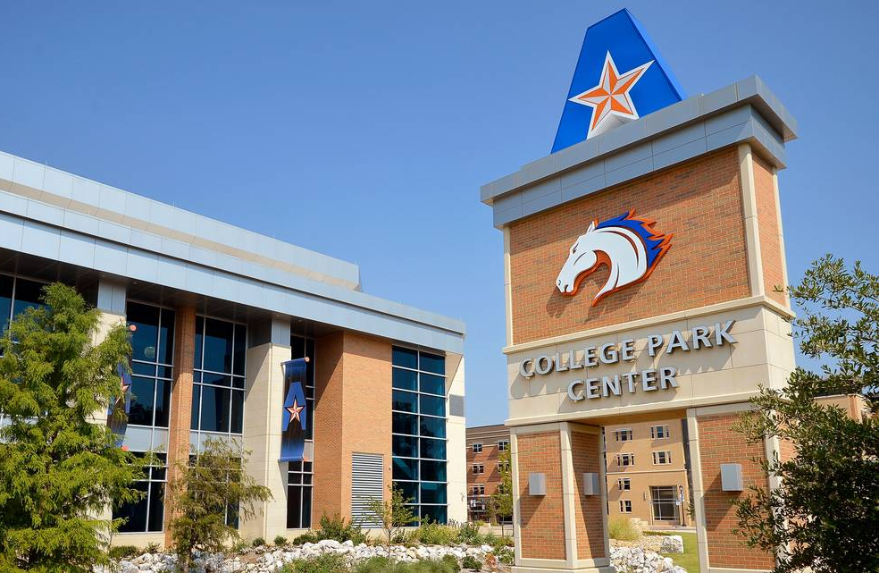
Our students are extremely diverse, a KEY STRENGTH
Hispanic-Serving and Asian American and Native American Pacific Islanders-Serving Institution
UTA graduates most African-American undergraduate and Master’s students in Texas
#1 Top Business School with most U.S. minorities (Poets & Quants, 2021)
College of Business Student Population
28% Hispanic, 24% White, 16% Asian, 11% African American,
18% International, 3% Multi-racial; 48% Female
Average Age: 25.5 years
28% of students have gross family income < $20,000
44% Pell grant eligible
Diversity, Racial Equity, & Inclusion Goal
Be the university of choice for organizations seeking diverse business students who are knowledgeable about diversity among applicants, employees, customers, and constituents and have tangible skills for working in diverse environments.

Slide 20
DIVERSITY NOTES TO KNOW, GIVEN OUR STUDENT BODY:
Name-based discrimination documented in multiple studies
African American, Hispanic, Asian, Non-distinguishable names
Gender-based grading discrimination documented
Grading biases toward liked students also documented

Slide 21
BLIND-GRADING IS RECOMMENDED WHEN POSSIBLE
Helpful to faculty and students
Canvas makes it easy
Also possible with physical documents
USE A RUBRIC, plus blind-grading
INCORPORATE DIVERSITY CONTENT INTO YOUR COURSES.
Notify me or the DREI Council member in your department

Slide 22
MANAGING DIVERSITY AND INCLUSION CERTIFICATE–ENROLLMENT HAS STARTED
Required Course:
Diversity in Organizations (201 students enrolled this fall; a record)
Elective Options (select two from this list; 171 students in these classes):
Disability and Work (new, Spring 2022))
Economics of Discrimination (new)
International Management
International Marketing
Multicultural Marketing
Please tell your students about the certificate.

Slide 23
Research Updates
Wendy Casper
COB Research Expense Grants and Impactful Research grants
Due to me by October 1
IRB update
COVID-19 changes
UTA is a Texas National Research University
It’s official!

Slide 24
Academic Integrity
Plagiarism, Cheating on Test/Assignment, and Collusion
Plagiarism: ‘Egregious Plagiarism,’ ‘Significant Plagiarism,’ and ‘Plagiarism’
Egregious Plagiarism Examples
More than 25% of the material from another source is copied or slightly adapted from the original without proper citations.
Purchasing and/or accepting a paper in its entirety from another source or person.
Egregious Plagiarism, Recommended Consequences
Referral to the Office of Community Standards, https://cm.maxient.com/reportingform.php?UnivofTexasArlington&layout_id=6
F-grade in the course.
Taskforce Chair: Dr. Larry Chonko

Slide 25
Academic Integrity
Cheating on Test/Assignments
Report the incident to the Office of Community Standards, https://cm.maxient.com/reportingform.php?UnivofTexasArlington&layout_id=6
First offense
Receive a grade of zero on the exam
Second offense
Receive a grade of F in the course

Slide 26
Academic Integrity
Research Misconduct
Making up information, data, or research results
Fabrication/falsification of data
Stealing credit for research accomplishments
PhD Students
Higher standards are expected
First time you are out precedent

Slide 27
Academic Integrity
Recommendations from the Office of Community Standards (Dan Moore)
Report violations when you see them
Utilize SafeAssign/Uncheck for written assignments
Use seating charts for exams
Set clear expectations with reminders through the semester
Stipulate guidelines in your syllabus

Slide 28
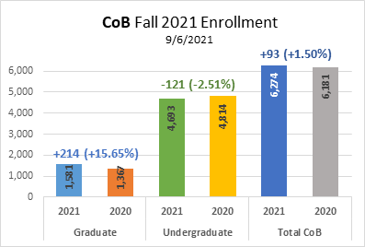
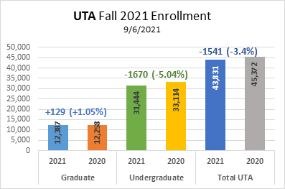
COB Fall 2021 Enrollment

Slide 29
COB Graduate Enrollment
ISOM Masters, 284 new students (218.5%)
Fall 2020, 130
Fall 2021, 414
HRM, 18 new students (36.7%)
Fall 2020, 49
Fall 2021, 67

Slide 30
Dean’s Comments

Slide 31
