Slide 1
Faculty/Staff Meeting
December 4, 2020
Notes:
The Powerpoint backgrounds are locked. You are able to still adjust the text boxes. You can edit the boxes size, location, font color, font size, etc.
If you have a change request, please send a request to the Marketing and Communications request portal.
https://resources.uta.edu/business/marketing-and-communications.php

Slide 2

Agenda
New staff/positions
Faculty searches
Announcements
Curriculum changes—voting
AACSB status
Budget overview
Dean’s update

Slide 3


New Staff
Welcome!
Kristin Brooks – Associate Director, GBS

Slide 4


New Positions
Congratulations!
  Philisa Stanford – Director of Diversity, Racial Equity, and Inclusion

Slide 5

Tenure-Track Faculty Searches
  No dedicated positions
  Each department can search for UTA’s 15 new faculty positions with the goal of hiring more minority faculty and women in STEM fields
  We are reserving an endowed chair position for one of these new hires

Slide 6

CoB Commencement
No in-person commencement
But virtual UTA graduate celebration:
Dec. 17th at 7:30 p.m.
http://www.uta.edu/commencement/

Slide 7

Announcements
Business Week 2021
  March 29 – April 2, 2021
  Theme is Diversity, Racial Equity, and Inclusion
  Probably scaled back from previous years
  Plans still under discussion
Wall Street Journal online access
  Free to students/faculty; paid by COB
  Whether we continue after this year depends on usage
COB building is locked

Slide 8


Faculty Voting
COB Bylaws state that only T/TT faculty may vote
Voting will be by email; Marybeth will send out after meeting; deadline is one week
Curriculum proposals require 60% approval

Slide 9


Curriculum Changes
Faculty voting
Catalog changes
Dr. Stephanie Rasmussen
Chair of Undergraduate Curriculum Committee

Slide 10


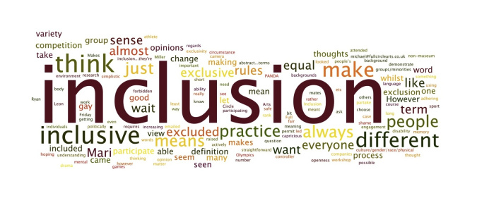
Diversity, Racial Equity, and Inclusion
Dr. Myrtle Bell

Slide 11

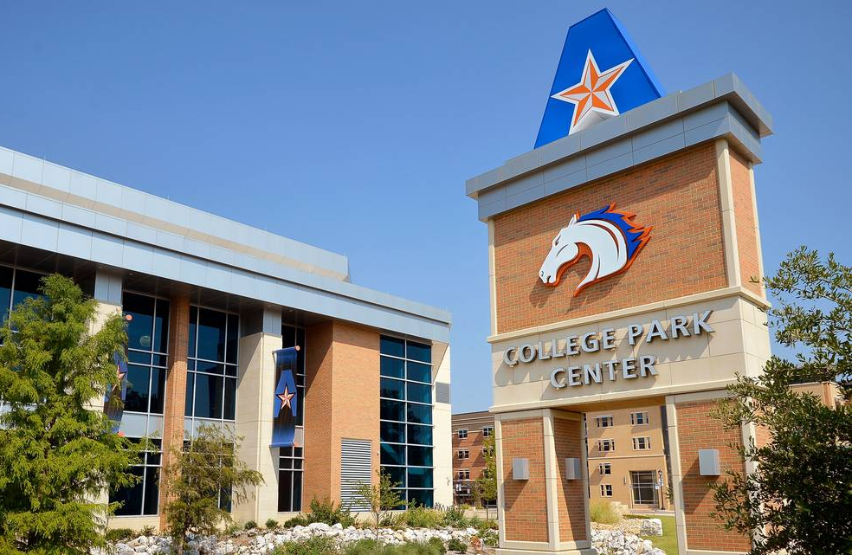
University of Texas at Arlington
Majority-Minority, Hispanic-Serving
  UTA graduates most African-American undergraduate and Masters students in Texas
  #2 Top Business School with most domestic minorities (Poets & Quants, 2020)
College of Business Student Population
  24% White
  28% Hispanic
  11% African American
  16% Asian
  18% International, 3% Multi-racial
  43% Female
  Average Age: 25.5 years
  28% of students have gross family income < $20,000
  44% Pell grant eligible
Diversity, Racial Equity, & Inclusion Goal
Be the university of choice for organizations seeking diverse business students who are knowledgeable about diversity among applicants, employees, customers, and constituents and have tangible skills for working in diverse environments.

Slide 12

Outstanding, resilient students
Bre Jones, a Human Resources Major, is a 2020 Society for Human Resource Management Foundation Undergraduate Scholarship winner: 1 of 43 nationwide
CPA testing success:
  UTA: 50.4% pass rate, Avg age 32.1
  UTD: 47.5% pass rate, Avg age 29.4
  UNT: 43.4% pass rate, Avg age 32
  SMU: 56.3% pass rate, Avg age 25.7
  TCU: 67.3% pass rate, Avg age 25.7
MSHRM program ranked top 5 or 6 in nation repeatedly.
Beta Gamma Sigma, 2020 Silver Award, only 1 of 600 BGS
chapters worldwide.

Slide 13





Program Updates
Dr. Fernando Jaramillo
Pass/Fail this semester
Increasing freshmen—reaching out
New BS in Business Analytics
New graduate certificate in Business Analytics
EMBA updates

Slide 14

AACSB Accreditation
AACSB – virtual team visit is Mar. 1-4, 2021 – 3 months
  5-year accreditation review
  3 pillars: Engagement, Innovation, Impact
  Societal Impact is a new focus area
  Assurance of Learning – faculty involvement
  Self-study report—send to team next week
  A dozen group meetings in March (Teams)

Slide 15


CoB Income Statement
Prepared by
Justin Smith

Slide 16
Revenues
Designated | $ 999,297.88
Designated Organized | 2,813,721.31
E&G | 20,601,891.89
EDT | 2,218,918.97
Growth Funds | 951,012.00
 | 27,584,842.05
Other Revenues
Dean's Faculty Excellence Endowment | 494,359.72
China Transfer | 1,771,128.02
Total Other Revenues | 2,265,487.74
Total Revenues | 29,850,329.79
Expenses
Faculty Salaries | 16,398,634.72
Admin. and Prof. Salaries | 4,957,721.75
Teaching Assistant Salaries | 1,338,934.30
Hourly Wages | 282,651.73
Benefits | 4,910,257.75
Operating Expenses | 2,653,700.10
Other Expenses | 633.35
Total Expenses | 30,542,533.70
Net Income (Loss) | $ (692,203.91)
End of Year Available Reserves | $ 4,187,636.54
College of Business
Simple Income Statement
Year Ending 8/31/2020
Not including restricted revenues/expenses, such as endowments and scholarships

Slide 17




Dean’s Update
Covid-19 continuing impacts
Strategic planning update
New budget model—impact on COB

Slide 18
Questions?

Slide 19



Good luck with finals!
Happy Holidays!

