Slide 1
Faculty/Staff Meeting
September 2019

Slide 2
Agenda
Welcome
Congratulations
Updates
AACSB Faculty Qualifications vote
VBOC and vmock
Library updates
Research news
AACSB accreditation review
Faculty Hiring
Development
Dean’s Comments
Strategic planning input

Slide 3
Welcome!
Welcome New Tenured/Tenure-Track Faculty!
Dr. Jivas Chakravarthy, ACCT
Dr. Andy Hansz, FINA
Dr. Chai Sambhara, ISOM
Dr. Zhuojun (ZJ) Gu, ISOM
Dr. Ariane Foidevaux, MANA
Dr. Yiyi Li, MARK
Dr. Fred Miao, MARK

Slide 4
Welcome!
Welcome New Non-Tenure-Track Faculty!
Dr. Cherie Henderson, ACCT
Mr. Ken Smith, ACCT
Dr. Chris Candreva, ECON
Dr. Robert Pettis, ECON
Dr. David Quigley, ECON
Dr. Grace Esimai, ISOM
Dr. Cynthia St. John, MANA
Mr. Wayne Brittingham, MANA
Dr. Kevin Carr, MARK
Dr. Melody Fowler, MARK
Dr. Anne Gottfried, MARK

Slide 5
Welcome!
Welcome New Staff!
Erica Anderson, Dean’s Office
Dominique Castillo, UG Advising
Sarah Davis, EMBA Program
Amanda Houdashell, MBA Program
Jordan Mulkey, Web Development
Victoria Porter, UG Advising
Hakim Sims, UG Recruiting
Gina Tilker, Development
Micah Washington, UG Advising
Will Wright, PhD Program

Slide 6
Congratulations!
Faculty Promotions!
Dr. Narayan Janakiraman, MARK (Tenure)
Dr. Fernando Jaramillo, MARK (Full Professor)

Slide 7
Congratulations!
New Endowed Chair!
Dr. Sanjiv Sabherwal
Goolsby-Jacqualyn A. Fouse Chair

Slide 8
Good News!
Elite journal acceptances for 2018-2019
Alison Birch (Hall)—Academy of Mgmt. Review
Narayan Janakiraman—Journal of Marketing
Kay-Yut Chen—Management Science
3 more this month!

Slide 9
More Good News!
3 Federal Research Grants!
Kay-Yut Chen – Agency for Healthcare Research and Quality -- ~$625k
CY Choi – National Oceanic and Atmospheric Admin. -- ~$300k
Jennifer Zhang – National Science Foundation -- ~$1million

Slide 10
More Good News!
Merit raises!
Faculty Development Leave—2019-20
Mahmut Yasar, ECON
Grand opening—Financial Markets Lab
New sculpture
Updating the ‘Collaboration Lounge’
Re-utilizing 3 rooms at end of each lab

Slide 11
COB Commencement
Saturday, December 14 at CPC
Arrive 10:15 in robes and hats (get now), curtain at 11
All T/TT faculty must attend (excuses approved by Dean and reported to President); NTT faculty extremely welcome
http://www.uta.edu/commencement/
Speaker: Sam Mahrouq
Spring is Sat., May 16

Slide 12
Other Items
AACSB Faculty Qualifications document
Need to vote on it (Vote was unanimous/ no opposition)
New COB workload policy
Digital Measures – update info for activity report
Progressing on CAMHE accreditation for HCAD
UNIV 1101 and 1131 (19 and 15 sections)
Business Week 2020 – March 23-27
CA⁺HME

Slide 13
Veterans Business Outreach Center
Patrick Alcorn

Slide 14
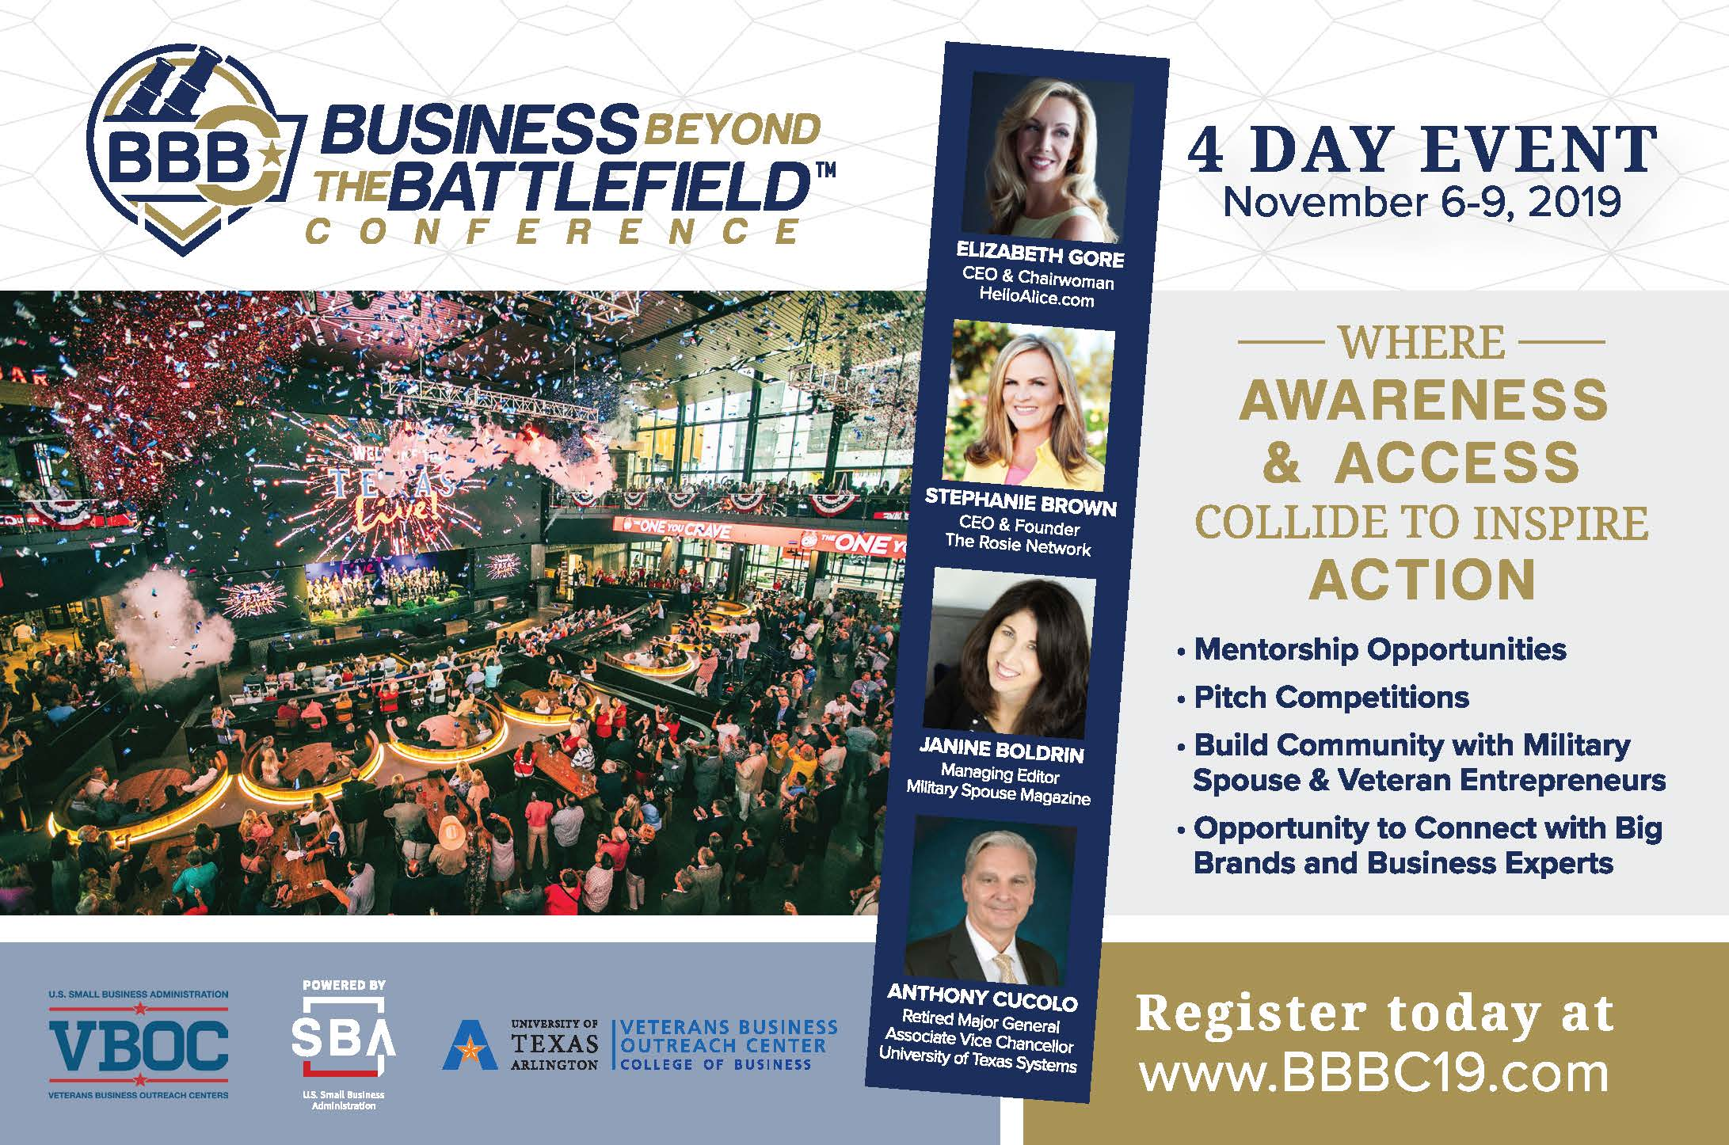
Business Beyond the Battlefield Conference
Veterans Enterprise of the Year award ceremony
Keynote speaker Jim Murphy, CEO of Afterburner hosted by Global Leaders Organization
Veterans Franchise Expo and the I9Sports franchise giveaway in partnership with VetFran and Veteran Franchise Advisers
Football watch party in the TexasLive! Arena with a 100 foot video screen
Government and corporate contract procurement showcase with supplier match making hosted by NVSBC and NaVOBA
Veterans Business Expo on the TexasLive! plaza allowing veteran retail businesses to generate immediate revenue
Up to 33 hours of customized training content for all phases of business development, including a complimentary Reboot for nascent entrepreneurs
Access to U.S. Small Business Administration resources partners, including access to capital partners
...and more.
#NVSBW19

Slide 15
Entrepreneur Development

Slide 16
PUBLIC EVENTS

Slide 17
vmock is here!
Melanie McGee
https://www.vmock.com/video

Slide 18
Library Updates
College of Business Librarians:
Ruthie Brock

Slide 19
Research Updates
Wendy Casper:
Faculty Research Expense Grants—competitive; up to $5k each – Fall and Spring
PhD student research grants—competitive; up to $2k each
Will be increasing PhD stipends next year

Slide 20
AACSB Accreditation
AACSB – next team visit is Feb. 2021 – 1.5 years out
5-year review cycle
Faculty qualifications
AOL committee
AOL vs. UEP; most data can be used for both
Innovation, Engagement, Impact
New 2020 AACSB standards

Slide 21
Faculty Hiring
7 T/TT Searches:
Endowed Chairs
West Chair – Healthcare or Entrepreneurship; any dept.
Goolsby-Alcon Chair – any dept.
ECON – Health or Environmental; Assistant
ISOM – Business Analytics; Assistant
MANA – Org. Behavior/HR; Assistant
MANA – free choice; Assistant
MANA – free choice; Assistant (NTT conversion)

Slide 22
UTA Giving Totals and Individual Donor Counts FY 17-18 and FY 19-20
Giving Totals
 | FY 17-18 | FY 18-19 (Not Final)
Gifts | $ 10,374,354 | $ 17,383,306
Pledges-Current | $ 1,414,678 | $ 3,933,089
Pledges-Capital | $ 719,158 | $ 716,785
New Testamentary Commitments | $ 2,805,263 | $ 1,630,000
 | $ 15,313,453 | $ 23,663,180
Individual Donor Count
 | FY 17-18 | FY 18-19 (Not Final)
Alumni | 3,195 | 3,502
Parents | 1,815 | 1,257
Friends | 2,064 | 1,727
 | 7,074 | 6,486

Slide 23
FY 2018‐19 Fundraising and Forecasting Totals for Business Through 8/31/19 (Not Final ‐ Updated 9/26/2019)
Total by Unit
Unit | FY 2017‐18 TOTALS |  |  |  | FY 2018‐19 YTD TOTALS
 | Gifts Received | New Pledges Outstanding | New Testamentary Commitments | Total | Gifts Received | New Pledges Outstanding | New Testamentary Commitments | Total
College of Business | $938,176 | $110,026 | $0 | $1,048,202 | $1,957,315 | $934,795 | $40,000 | $2,932,110
 | $938,176 | $110,026 | $0 | $1,048,202 | $1,957,315 | $934,795 | $40,000 | $2,932,110
Unit Total by Source
Source | FY 2017‐18 TOTALS |  |  |  | FY 2018‐19 YTD TOTALS
 | Gifts Received | New Pledges Outstanding | New Testamentary Commitments | Total | Gifts Received | New Pledges Outstanding | New Testamentary Commitments | Total
Alumni | $380,200 | $109,926 | $0 | $490,126 | $1,365,270 | $904,152 | $40,000 | $2,309,422
Friends | $30,165 | $0 | $0 | $30,165 | $28,642 | $5,488 | $0 | $34,130
Parents | $8,200 | $0 | $0 | $8,200 | $5,645 | $105 | $0 | $5,750
Companies | $179,000 | $100 | $0 | $179,100 | $253,691 | $25,050 | $0 | $278,741
Foundations | $197,250 | $0 | $0 | $197,250 | $177,000 | $0 | $0 | $177,000
Other Organizations | $143,361 | $0 | $0 | $143,361 | $127,067 | $0 | $0 | $127,067
 | $938,176 | $110,026 | $0 | $1,048,202 | $1,957,315 | $934,795 | $40,000 | $2,932,110

Slide 24
Dean’s Comments
Dean’s Leadership Circle (DLC)
MAVS 100

Slide 25
Strategic Planning
7 Goals

Slide 26
Questions? Comments?

