Slide 1
Faculty/Staff Meeting
May 2020

Slide 2
Welcome!
Welcome to the first-ever virtual CoB Faculty/Staff meeting!!

Slide 3
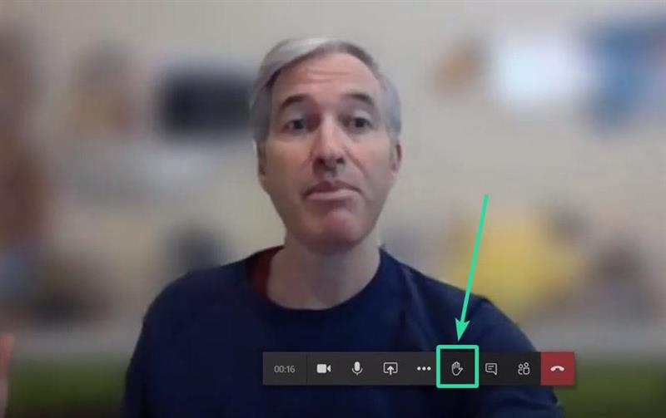
Virtual Meeting Format
Using Chat feature for questions
Raising-your-hand feature

Slide 4
Agenda
Welcome
Promotions
Awards and Recognitions
Updates
Dean’s comments
Q&A
Reception (on your own)

Slide 5
Promotions
New Job
Nancy Fletcher
EMBA Program Coordinator
Promotion to Full Professor
Mahmut Yasar (ECON)
Salil Sarkar (FINA)
George Benson (MANA)

Slide 6
Teaching Awards
Teaching Awards Committee:
Drs. Crowder, Tom Hall, Sarkar, Nerur, Lavelle, Freling
Outstanding Graduate Teaching Associate:
Nima Vafai (FINA) and Joohan Lee (MANA)
Outstanding Adjunct Instructor: Tram Le (ACCT)
Outstanding Clinical Professor: Christy Spivey (ECON)
Outstanding Undergraduate Teaching: Jennifer Ho (ACCT)
Outstanding Graduate Teaching: Nandu Nagarajan (ACCT)

Slide 7
Research Awards
Research Committee:
Drs. Saini, Skantz, Choi, Villupuram, Chen and McFadyen
Distinguished Research Publication Award:
Jivas Chakravarthy – Review of Accounting Studies, 2019
“Ideological Diversity in Standard Setting”

Slide 8
Research Awards
Distinguished Clinical Faculty Publication Award:
Heather Philip – Journal of Marketing Theory and Practice, 2019
“Exploring Online Peer-to-Peer Swapping: A Social Practice Theory of Online Swapping”

Slide 9
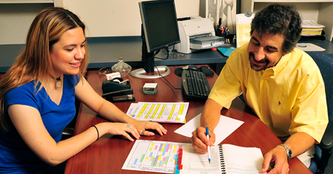
Advising Awards
Outstanding Undergraduate Advisor:
Ellen Long and Denise Wylie
Outstanding Graduate Advisor:
Sriram Villupuram (MS Real Estate)

Slide 10
Outstanding Staff Award
*Shunda Dixon*
“Shunda has exhibited great leadership and attention to detail.”
“Above all, she always seems to be full of joy as she accomplishes her tasks. This brightens the work place and makes her a tremendous asset to the Accounting Department.”
“Always willing to help, her positive attitude welcomes anyone who needs assistance.”

Slide 11
Lockheed Martin Community and Professional Faculty Leadership Award
This award recognizes faculty who have made significant contributions to the professional community
Larry Chonko
For his efforts in promoting ethics in business (and in sales)

Slide 12
Important Announcement
Good news – no need to sign anything to receive your award money this year!

Slide 13
UTA Awards and Recognitions
Wendy Casper
Excellence in Doctoral Mentoring Award

Slide 14
Other Awards and Recognitions
Edmund Prater
Jefferson Science Fellowship
12 months in Washington, D.C.
Starts August 2020
U.S. Department of State

Slide 15
Beta Gamma Sigma
Recently announced:
Outstanding Chapter Award
Silver Award
Faculty Advisor: Stephanie Rasmussen

Slide 16
Carla Buss Scholarship Winner
by Wendy Casper
Lei Hua (ISOM)

Slide 17
COB Research Expense Grants
Nandu Nagarajan (ACCT)
David Rakowski (FINA)
Christopher Candreva (ECON)
Jim Lavelle (MANA)

Slide 18
COB Impactful Research Grants
CY Choi (ECON)
Mike Ward (ECON)
Radha Mahapatra (ISOM)
Alison Birch (MANA)

Slide 19
UTA Target of 200+ PhD Grads
Postdoc possibility
Joohan Lee and Tushar Shah

Slide 20
New Faculty for Fall 2020
Full-time:
ACCT – 2 tenure-track
ISOM – 1 tenure-track & 1 NTT
MANA – 3 tenure-track

Slide 21
Retirements
Happy Retirement to:
Deepak Datta
Michael Richarme
Carolyn Davis—almost

Slide 22
Faculty in the News (recently)
Traci Freling and Ritesh Saini
Consumer decisions: emotional vs. fact-based
Bill Crowder and Bill Seeger
Speakers at Arlington Chamber of Commerce

Slide 23
Commencement
Postponed?
Cancelled?
Combine with Summer comm.?

Slide 24
Faculty Elections
Thanks to Tom Hall
for taking care of elections via email
for faculty committees

Slide 25
Enrollment numbers for Fall (as of today)
Total Grad + UG
COB: down 15% UTA: down 5%
Total UG
COB: down 13% UTA: down 0.5%
Total Grad
COB: down 25% UTA: down 21%
New Freshman
COB: up 100% UTA: up 63%
New Transfers
COB: up 93% UTA: up 56%

Slide 26
China EMBA Programs
The programs are going well in all three sites in China and the one in Taipei with several cohorts going on in each location. The Chinese universities are still closed so both they and we conduct on line synchronous and asynchronous classes. We had to reschedule a handful of courses but all seems to be working fine for the time being. In Taipei the university is open so their faculty teach face to face while we teach online. The future is tricky in China from a political standpoint but, that aside, for this year we have filled our quota in recruiting targets in Xi’an and Beijing but we are lagging significantly in Shanghai due to various reasons. Taipei will be fine but we expect maybe a lower number due to the very bad economic situation that they are faced with. Some of the students recruited fear that they will not have the resources to pay come fall and thus not be able to join the program.

Slide 27
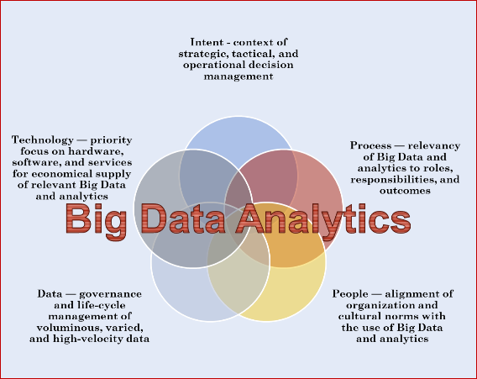
ISOM Initiatives
Radha Mahapatra:
Ericsson
BS Business Analytics

Slide 28
MBA Updates
Fernando Jaramillo:
Admissions through Peregrine learning modules on Statistics, Economics, and Management.
New scholarship to incentivize GMAT
Cohort MBA now offering HCAD and REAE concentration options.

Slide 29
Covid-19 Student Surveys
Email sent to 5,890 students. Received 763 responses from 609 undergraduates, 153 graduates, and 1 PhD student.
Student concerns:
How has COVID19 personally affected you?
Difficulties related to their student role (57.9%, 810/1,398)
Job related concerns (24%, 336/1398)
Family and health (18%, 252/1398)

Slide 30
Covid-19 Student Surveys
Is there something that the College of Business can do to support you at this time?
Ensure courses have reasonable workloads during the COVID-19 pandemic.
“I have one request: please have professors stop saying we have so much time on our hands.”
Show flexibility and empathy toward students.
“We are struggling financially, mentally and physically and I feel no empathy from professors or faculty.”
Ensure fair grading.
“Make professors stop grading more harshly than necessary. A lot of us are under a lot of financial, emotional and physical stress.”
Alleviate the financial burden of reduced income due to COVID-19.
“Connect students to potential internships opportunities.”
“Offer more scholarships or discount summer tuition.”

Slide 31
Dean Harry Dombroski
Current status:
University cost containment announcement
-- no plans for furloughs or layoffs
CoB plans related to cost containment
CARES Act Update
Presidential Search Update
Fall 2020 Update
Issues/Concerns:
Fall Enrollment
Potential budget shortfalls

Slide 32
Dean Harry Dombroski
Continuing University Initiatives:
Tier 1 Status
Potential new University Budget Model

Slide 33
Questions?

Slide 34
Reception in your home

