Slide 1
Going Places…
with UTA Sales Program

Slide 2
Business Sales Competitions!!
Connecting Top Recruiters and students!

Slide 3
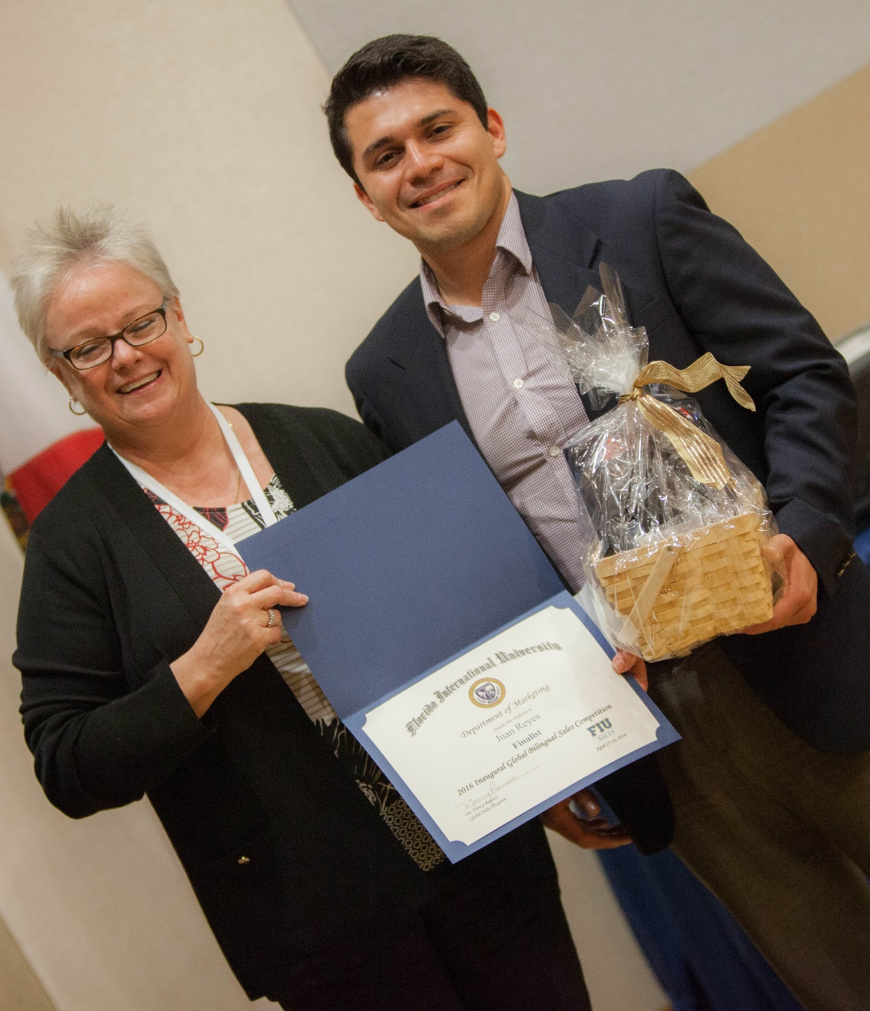
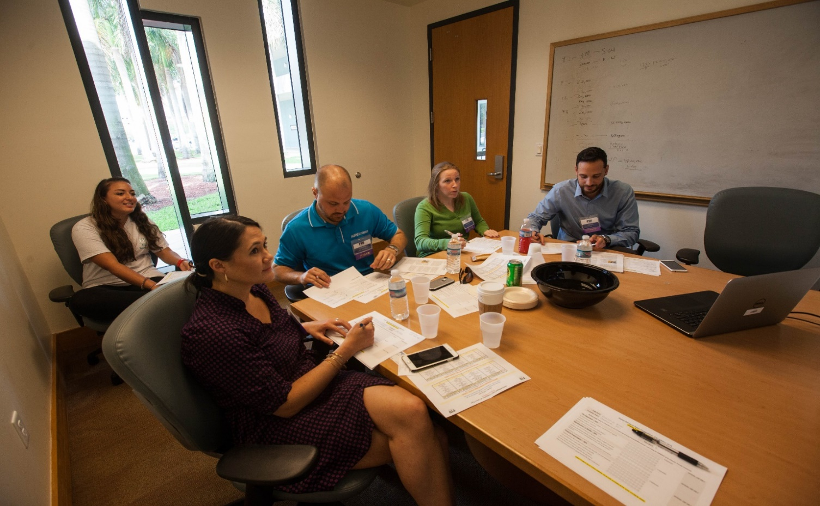
FIU Global Bilingual Sales Competition
2016, 4th Place Overall- Juan Reyes
Participants: Juan Reyes, Luis Carlos Salinas, and Marylin Briseno

Slide 4
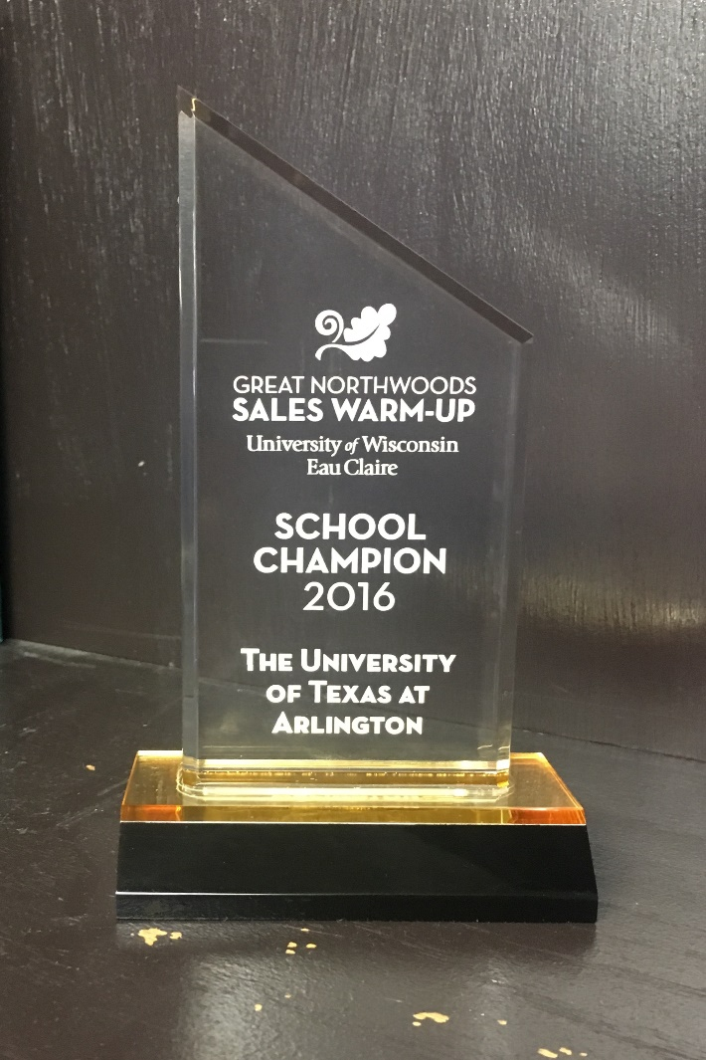
Great Northwoods Sales Warmup
2016, School Champion- Michael Barrett
Participants: Michael Baker II, Michael Barrett, and Elyssa Whaley

Slide 5
National Sales CHALLENGE
2016, Semi-Finalist
Participants:
Michael Barrett
and Tonya Evans

Slide 6
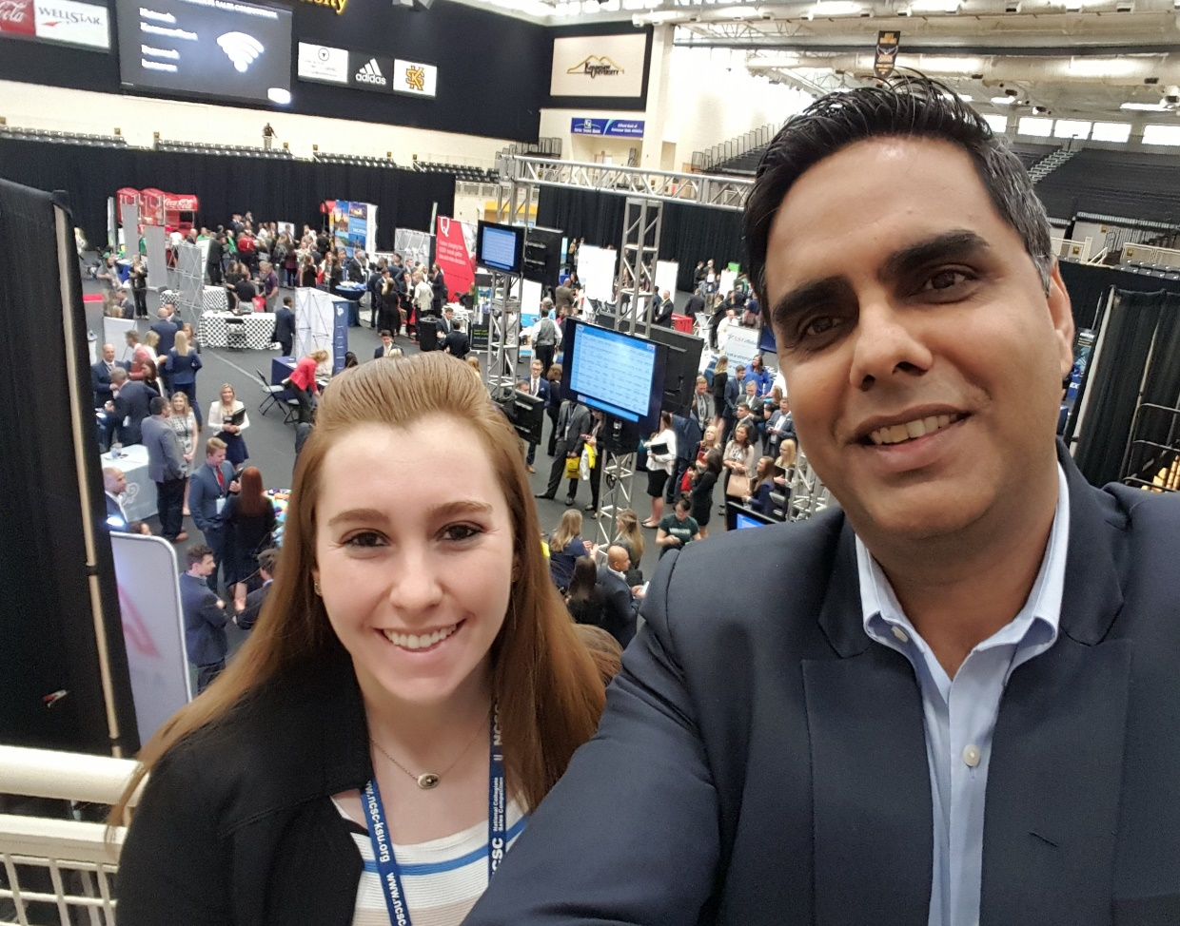
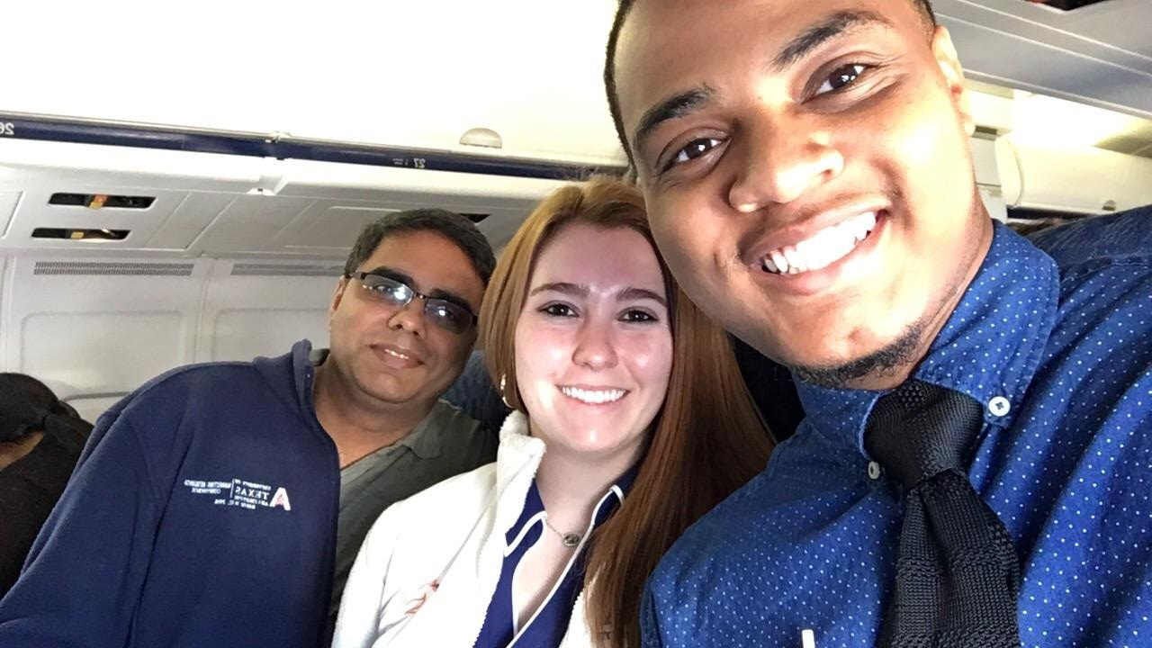
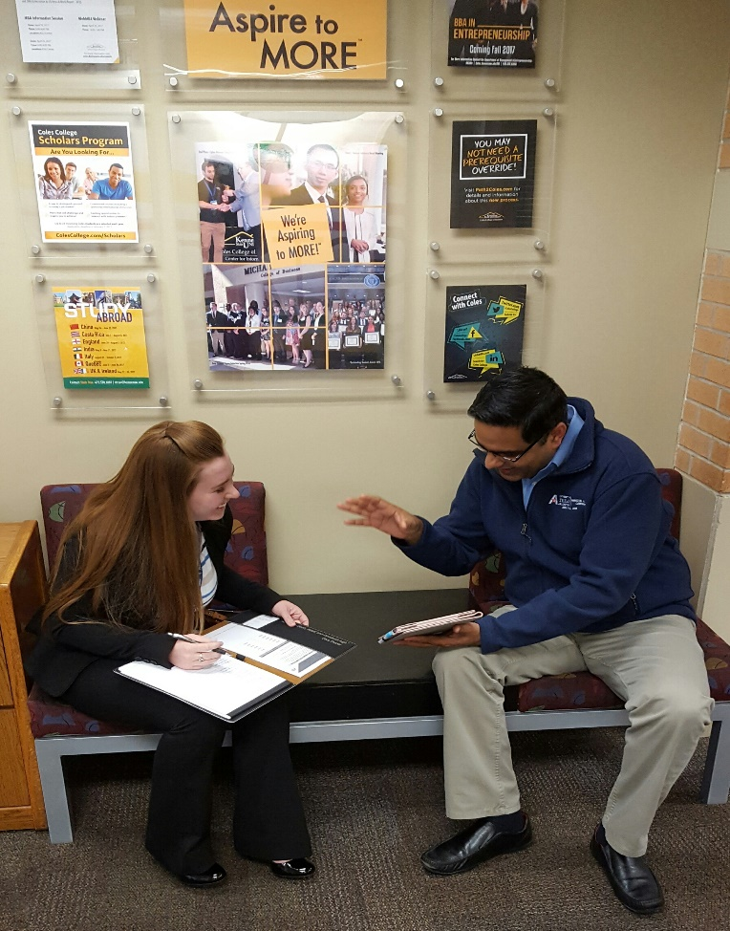
National Collegiate Sales Competition
Spring 2017
Participants: Michael Baker II and Kristin Moore

